Slide 1




PDS
AWS Auto Scaling and
Load Balancing
Computer Vision
https://github.com/siagianp
https://www.youtube.com/@AmelOline/videos
https://github.com/amelcharolinesgn2/Cloud-Infrastructures
https://github.com/amelcharolinesgn2/ClouD-Infrastructure-SISKA-2025
https://github.com/amelcharolinesgn2/CCNA1
https://github.com/amelcharolinesgn2/CCNA2
https://github.com/amelcharolinesgn2/AWS Certificate
Notes:
Lab Session 01: AWS Compute Foundations – EC2, Networking, and Application Deployment Lab Session 02: Identity and Access Control with IAM Lab Session 03: Cloud Storage Solutions – S3, EBS, and EFS Lab Session 04: Database Services – RDS, DynamoDB, and ElastiCache Lab Session 05: Load Balancing and Auto Scaling Lab Session 06: Container Orchestration with ECS, Fargate, and EKS Lab Session 07: Serverless Computing with Lambda Lab Session 08: Monitoring, Logging, and Security Auditing Lab Session 09: Infrastructure as Code – CloudFormation, CDK, and Terraform Lab Session 10: CI/CD Pipelines – App Runner, CodePipeline, GitHub Actions, and CodeDeploy Lab Session 11: AI/ML Services – Rekognition, Comprehend, Translate, and SageMaker Lab Session 12: Hybrid Cloud Networking – VPC Peering, Transit Gateway, VPN, and Direct Connect Lab Session 13: Security and Compliance – AWS Config, GuardDuty, Security Hub, and KMS Lab Session 14: Disaster Recovery and Business Continuity – AWS Backup, Multi-Region, and Failover Lab Session 15: Migration and Modernization – DataSync, DMS, MGN, Containers, and Serverless
Lab Session 16: Cost Management and Optimization – Cost Explorer, Trusted Advisor, Budgets, and Well-Architected
https://www.youtube.com/watch?v=SOTamWNgDKc&t=19604s

Slide 2
AWS Auto Scaling and
Load Balancing
Optimizing Scalability and Availability in the Cloud

Slide 3
Agenda
Auto Scaling
Load Balancing
Key Features and Benefits
How They Work Together
Use Cases
Real-World Examples
Demo (Optional)
Summary

Slide 4
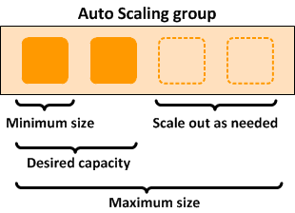
Auto Scaling
Automatically adjusts the number of compute resources to meet demand.
Key Benefits:
Ensures application availability.
Reduces costs by scaling down during low traffic.
Improves performance during traffic spikes.

Slide 5
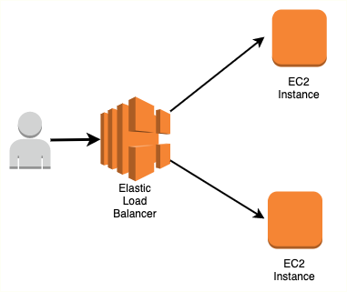
Load Balancing
Distributes incoming traffic across multiple resources to prevent overloading any single resource.
Types of Load Balancers in AWS:
Application Load Balancer (ALB): Layer 7 (HTTP/HTTPS) routing.
Network Load Balancer (NLB): Layer 4 (TCP/UDP) routing.
Classic Load Balancer: Legacy support for Layer 4 and 7.

Slide 6
Key Features and Benefits
Auto Scaling Features:
Dynamic Scaling: Automatically adjusts resources based on traffic.
Predictive Scaling: Uses machine learning to predict demand patterns.
Scheduled Scaling: Pre-defined scaling based on known traffic times.
Load Balancing Features:
Health Checks: Ensures traffic is sent only to healthy instances.
Sticky Sessions: Keeps user sessions connected to the same instance.
SSL Termination: Manages SSL decryption to offload instance workload.
Cross-Zone Load Balancing: Distributes traffic evenly across zones.

Slide 7
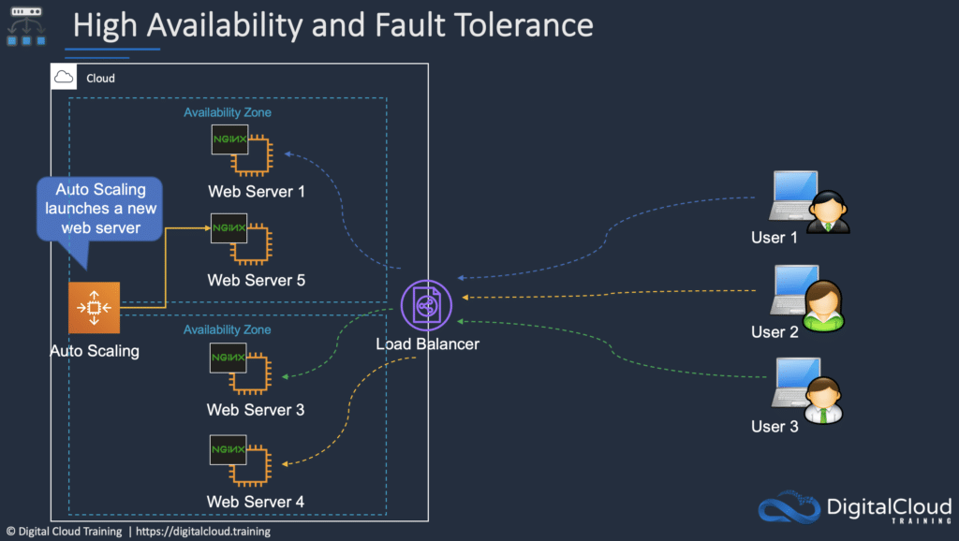
How They Work Together
Scenario: High traffic to a web application.
Load Balancer distributes traffic to multiple instances.
Auto Scaling adds more instances as traffic increases.
When traffic decreases, Auto Scaling reduces instances to save costs.
Outcome: Improved performance, reduced costs, and no downtime.

Slide 8
Use Case
E-commerce Platforms: Handle seasonal traffic spikes during sales events.
Media Streaming: Maintain smooth streaming by scaling resources based on viewer demand.
Web Applications: Ensure high availability and seamless user experiences.

Slide 9
Real-World Example
Case Study:
A streaming service like Netflix uses Auto Scaling to dynamically allocate resources during new show launches.
Load Balancers ensure traffic is evenly distributed among servers to prevent crashes.
Metrics:
99.99% uptime.
Significant cost savings during off-peak hours.

Slide 10
Demo Step
Step 1: Create an Auto Scaling group in the AWS Management Console.
Step 2: Attach an Application Load Balancer.
Step 3: Configure scaling policies and health checks.
Step 4: Monitor scaling activities in CloudWatch.

Slide 11
Summary
Auto Scaling ensures cost-efficient scalability by adjusting resources dynamically.
Load Balancing enhances application availability and distributes traffic efficiently.
Together, they form the backbone of resilient cloud architectures.

Slide 12
THANK YOU
Amel charoline
Amel Online & Irene magdalena
https://github.com/siagianp
https://www.youtube.com/@AmelOline/videos
https://github.com/amelcharolinesgn2/Cloud-Infrastructures
https://github.com/amelcharolinesgn2/ClouD-Infrastructure-SISKA-2025
https://github.com/amelcharolinesgn2/CCNA1
https://github.com/amelcharolinesgn2/CCNA2
https://github.com/amelcharolinesgn2/AWS Certificate

